Slide 1
Signals and Systems
Lectures # 13 and # 14
Laplace Transform
Prepared by:
Dr. Mohammed Refaey

Slide 2
Topics of the lecture:
Definition and Importance.
Region of Convergence (ROC) and its Properties.
Inverse Laplace Transform.
Laplace Transform Properties.

Slide 3
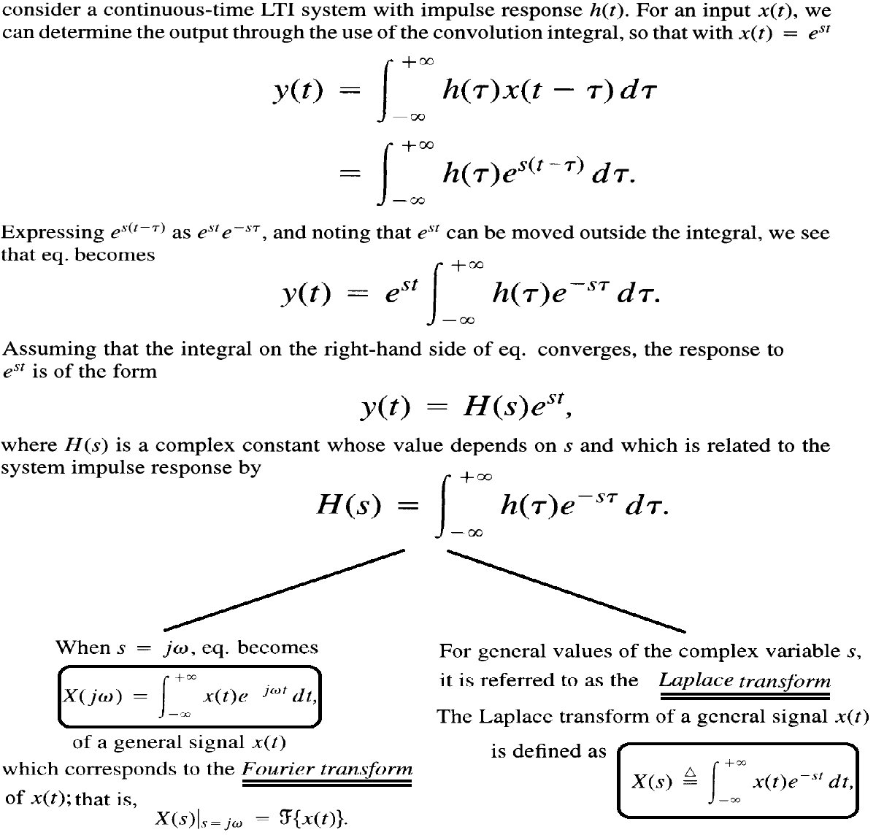
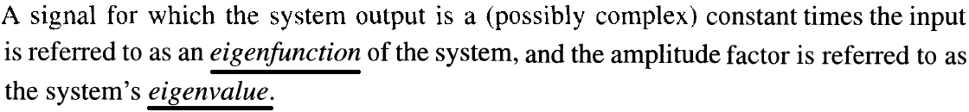
Definition and Importance.

Slide 4
Definition and Importance.
Definition:
The Laplace Transform of a continuous-time signal is defined as:
Where s is a complex variable and in general s = σ + jw
Importance:
- The Laplace Transform provides a good tool for easier analysis of continuous-time systems even if it may be unstable using useful algebraic properties extending the Fourier Transform tools to analyze more complex systems.
- The Laplace Transform convert many difficult or daunting Time-Domain operations such as : Convolution, Time-Shifts, Differentiation, and Integration into algebraic operations {+ , - , x , / }.

Slide 5
Definition and Importance.
Example 1: compute the Laplace transform of the signal
Remember that any complex number z=|z|e^{jArg{z}} doesn’t go to ∞ unless it’s magnitude |z| goes

Slide 6
Definition and Importance.
Example 2: compute the Laplace transform of the signal
Remember that any complex number z=|z|e^{jArg{z}} doesn’t go to ∞ unless it’s magnitude |z| goes

Slide 7
Region of Convergence (ROC) and its Properties.
From Example 1:
From Example 2:
Note : Same Algebraic expression BUT different set of S to converge
Then: to specify/determine the Laplace Transform both algebraic expression and Region Of Convergence (ROC) are required.
With ROC is the set of values of S for which the algebraic expression converges.

Slide 8
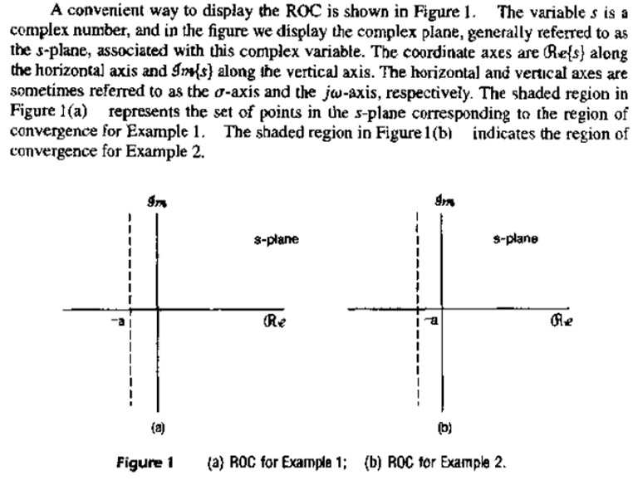
Region of Convergence (ROC) and its Properties.

Slide 9
Region of Convergence (ROC) and its Properties.
Example 3: compute the Laplace transform of the signal
From Example 1:
In order to determine the ROC, we need the set values of s for which both algebraic expressions converge simultaneously. i.e. the intersection of ROC1 and ROC2

Slide 10
Region of Convergence (ROC) and its Properties.
Example 4: compute the Laplace transform of the signal

Slide 11
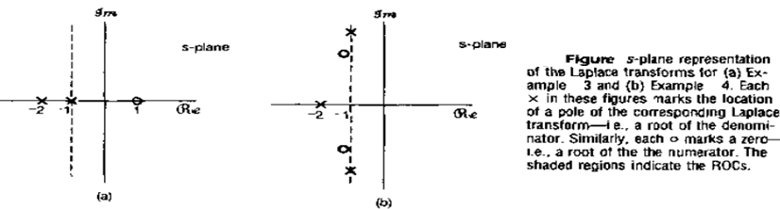
Region of Convergence (ROC) and its Properties.
Laplace Transform (L ) is rational for linear combination of real and complex exponential signals, also for LTI systems specified in terms of linear constant-coefficient differential equations.
Rational L means
For rational L : Roots of N(s) are called Zeros and Roots of D(s) are called Poles
A convenient way of describing the L is to mark the locations of Zeros and Poles in S-Plane and indicating the ROC , then this plot is called Pole-Zero plot.
Rational

Slide 12
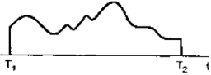
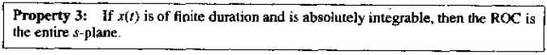
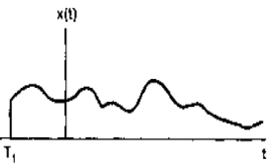
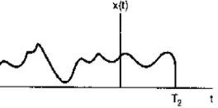
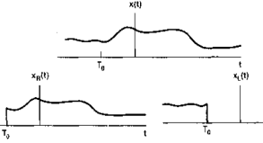
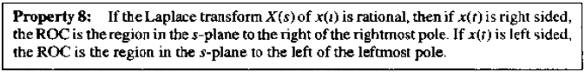
Region of Convergence (ROC) and its Properties.
Keep the exponential decaying remember sign of t, i.e. st>0
intersection

Slide 13
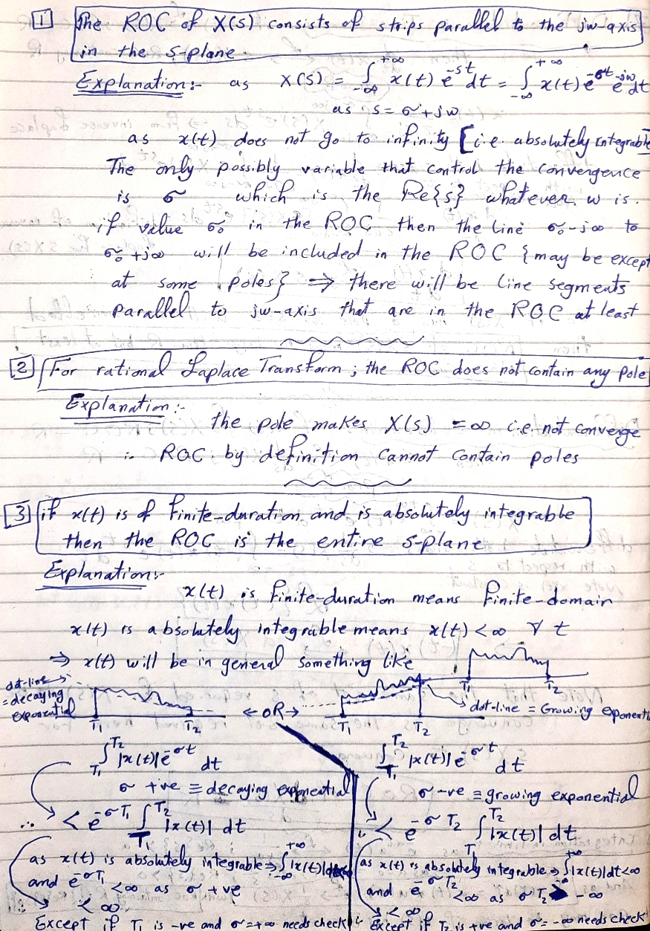
Region of Convergence (ROC) and its Properties.

Slide 14
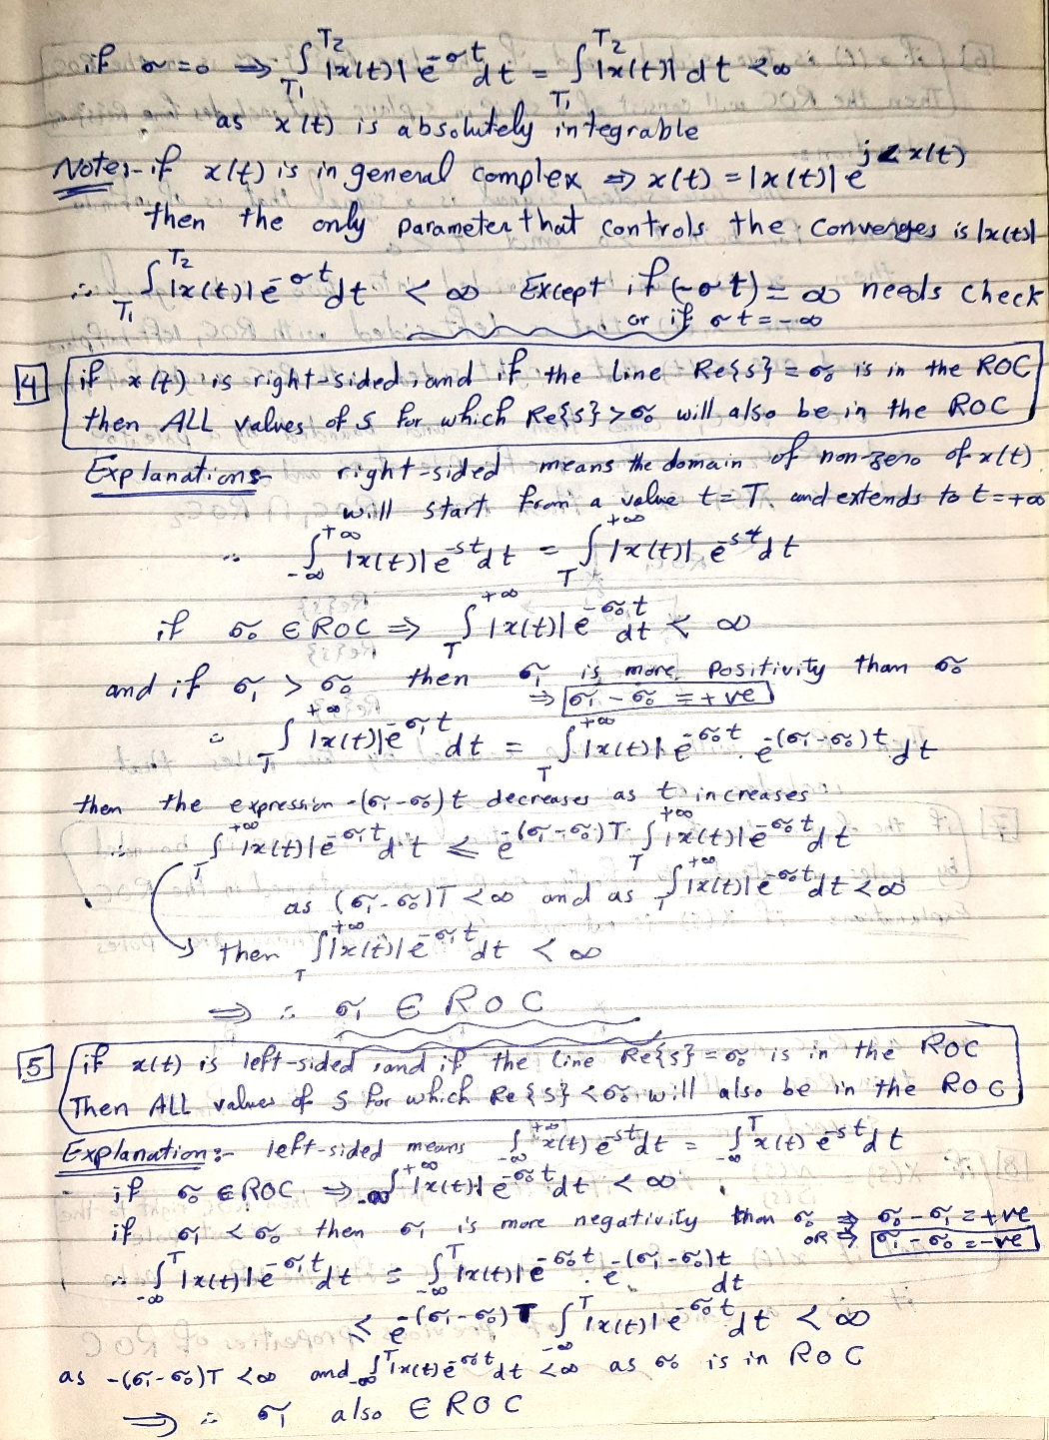
Region of Convergence (ROC) and its Properties.

Slide 15
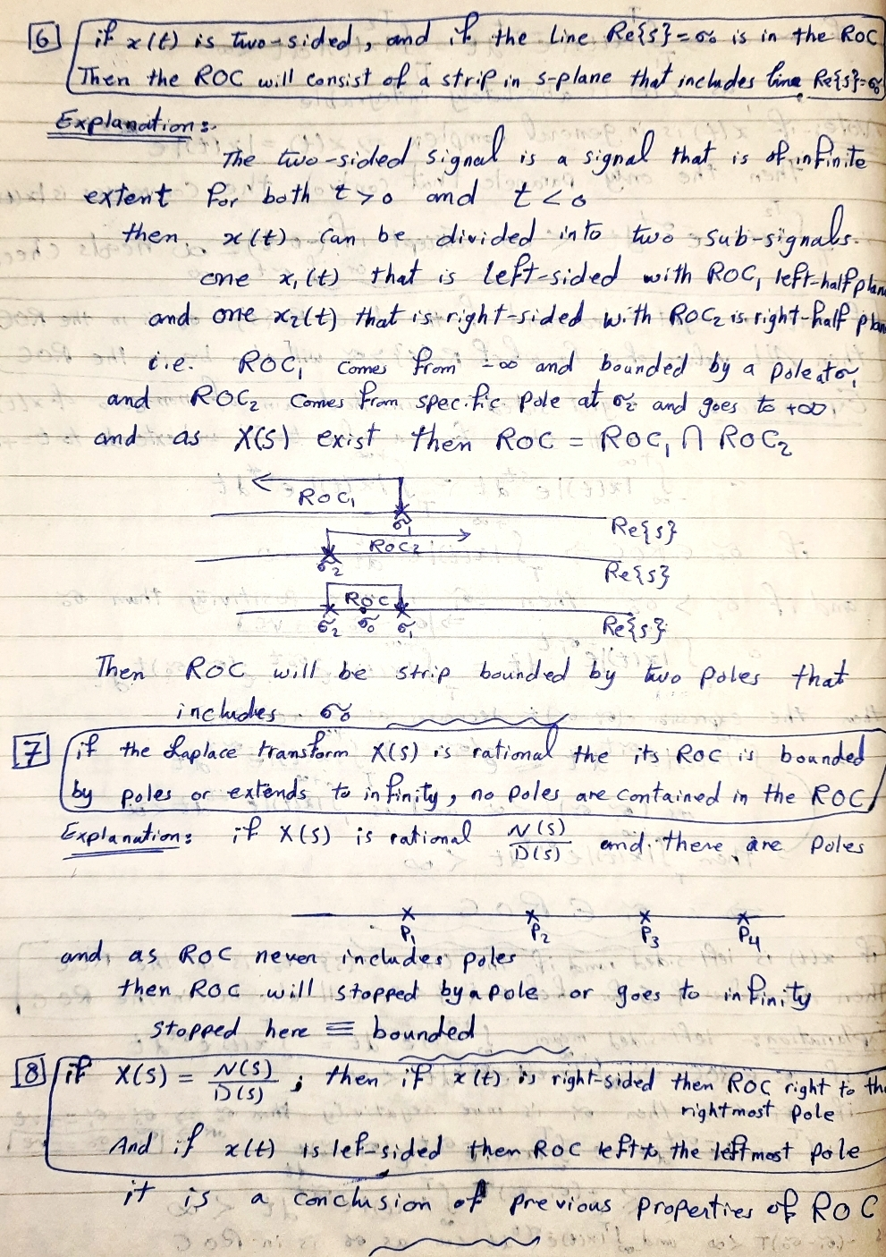
Region of Convergence (ROC) and its Properties.

Slide 16
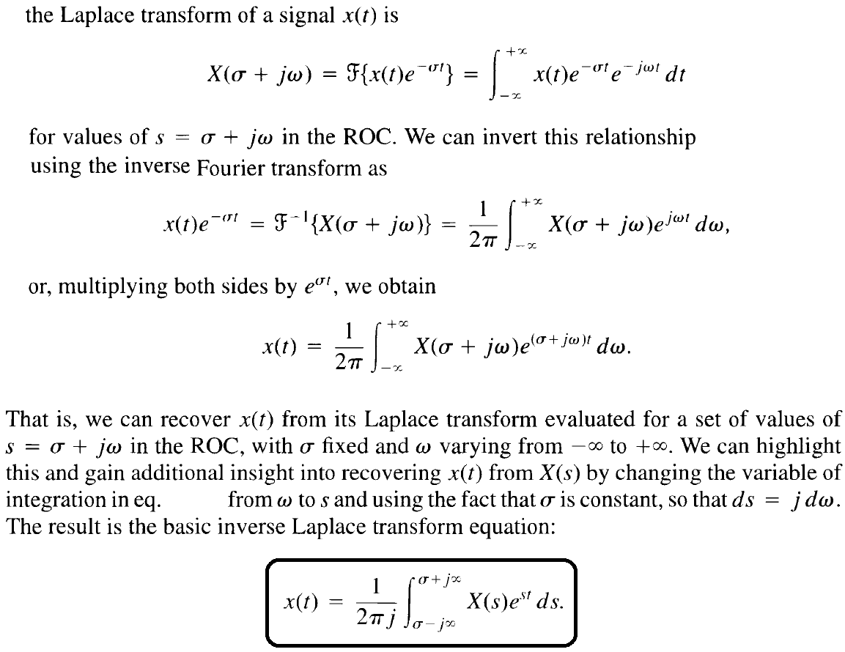
Inverse Laplace Transform.

Slide 17
Inverse Laplace Transform.
Definition:
The Inverse Laplace Transform is defined as:
Where s is a complex variable and in general s = σ + jw
The formal evaluation of the integral for a general X(s) requires the use of contour integration in the complex plane, a topic that we will not consider here.
The basic procedure for computing the Laplace inverse is to decompose the Laplace Transform algebraic expression using the partial fraction decomposition into a linear combination of lower order terms.
Then, use the known pairs to get the Inverse Laplace Transform.

Slide 18
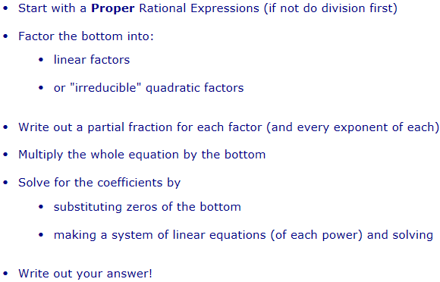
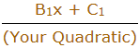
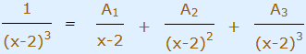
Inverse Laplace Transform.
Partial Fraction Decomposition:
http://www.mathsisfun.com/algebra/partial-fractions.html
Proper: the degree of the top is less than the degree of the bottom. The degree is the largest exponent the variable has.
But don't factor it into complex numbers
A quadratic is a second-order polynomial, and if you have one write its factor as ➔
Sometimes you may get a factor with an exponent, like (x-2)³ ... You need a partial fraction for each exponent from 1 up

Slide 19
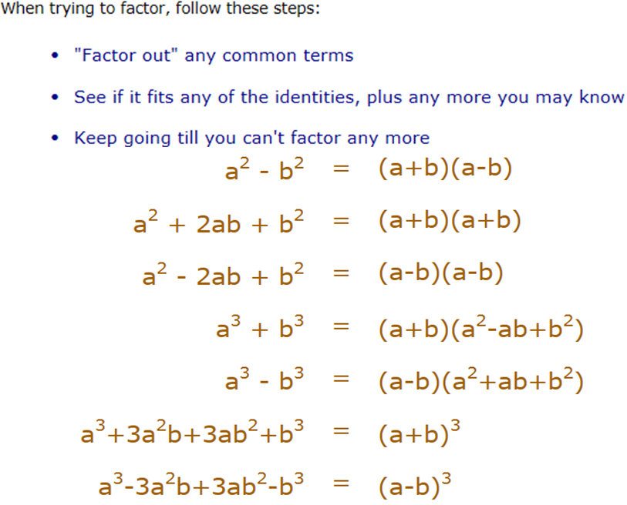
Inverse Laplace Transform.

Slide 20
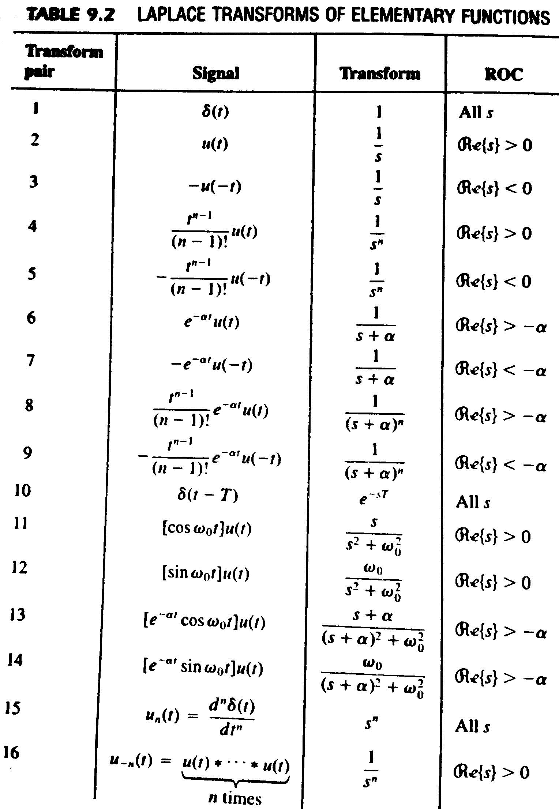
Inverse Laplace Transform.

Slide 21
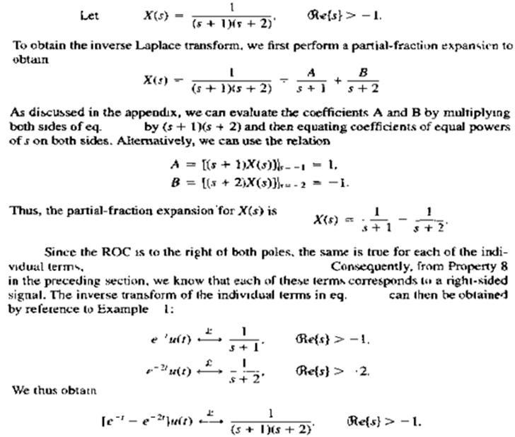
Inverse Laplace Transform.

Slide 22
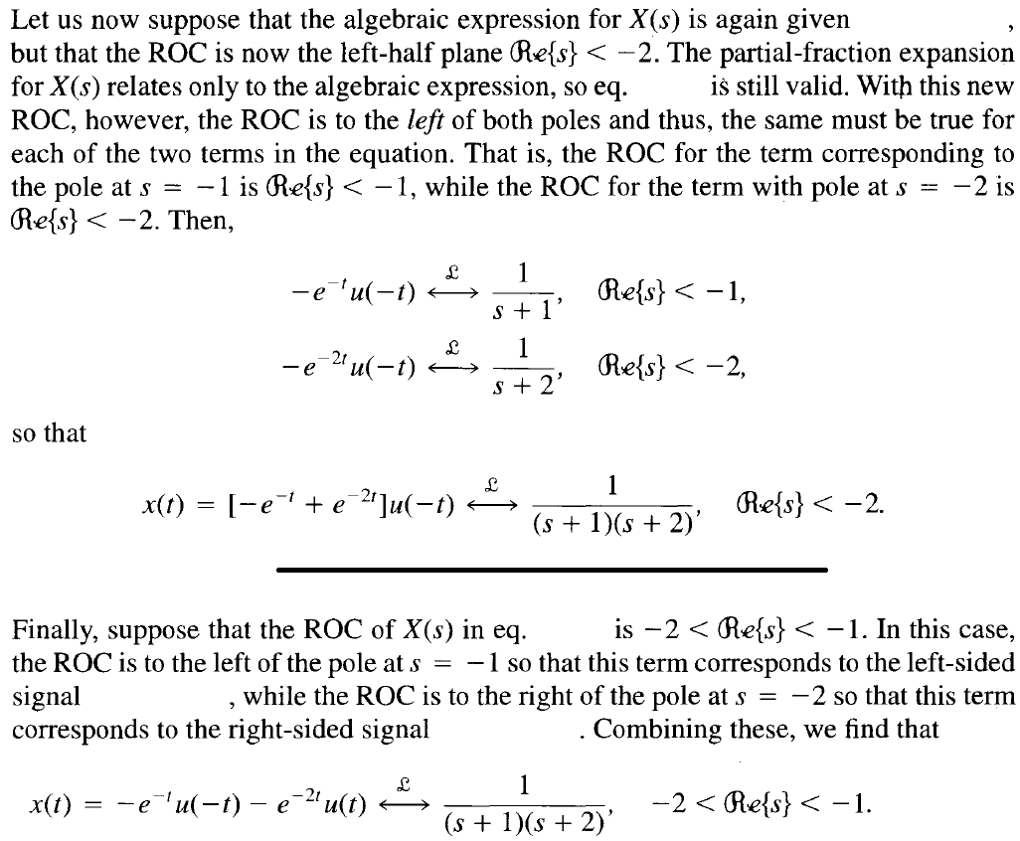
Inverse Laplace Transform.

Slide 23
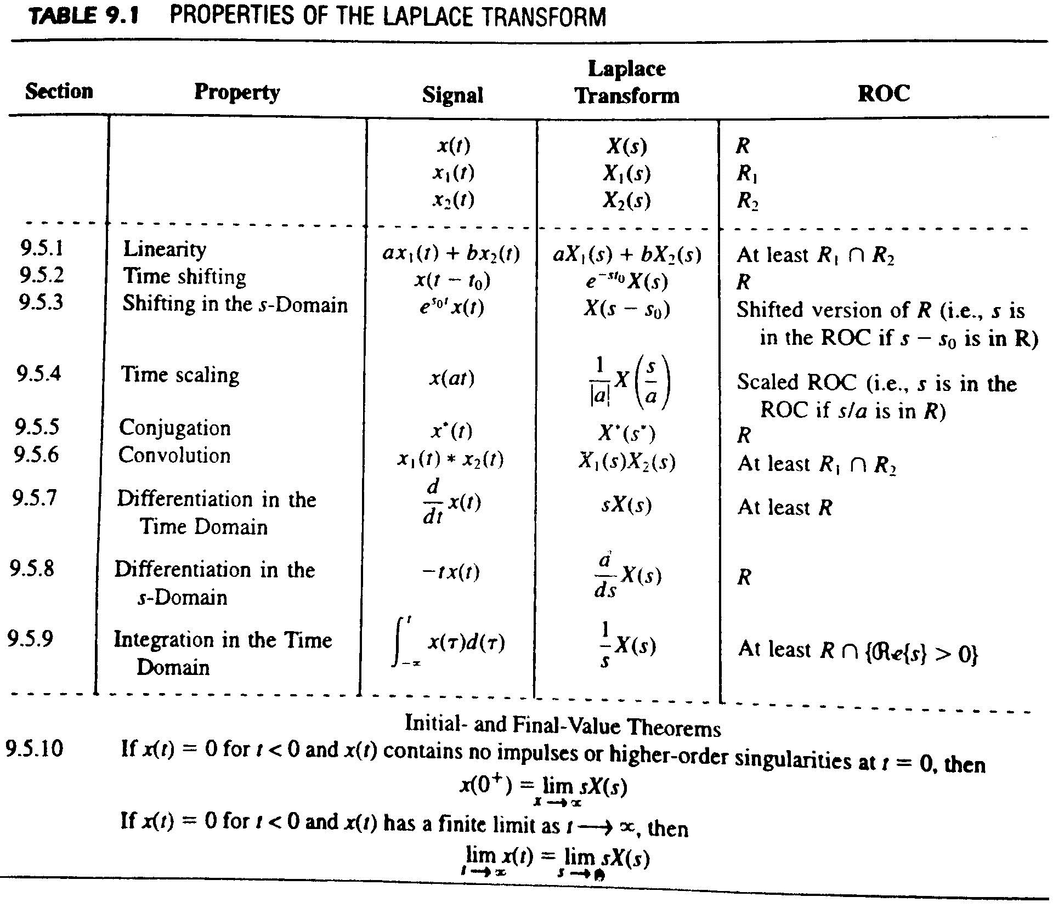
Laplace Transform Properties.

Slide 24
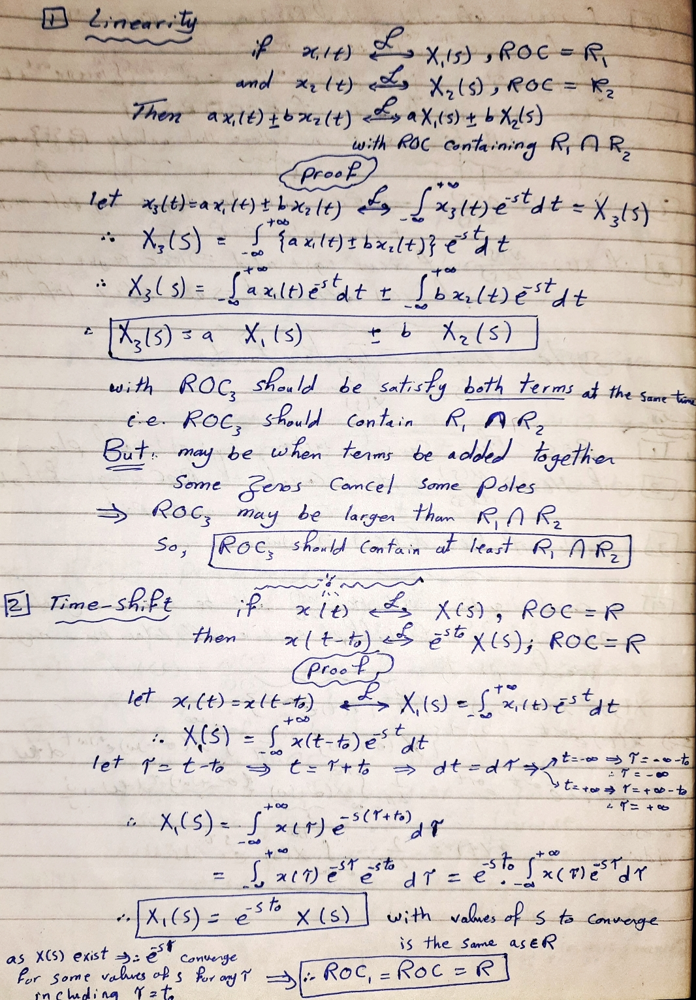
Laplace Transform Properties.

Slide 25
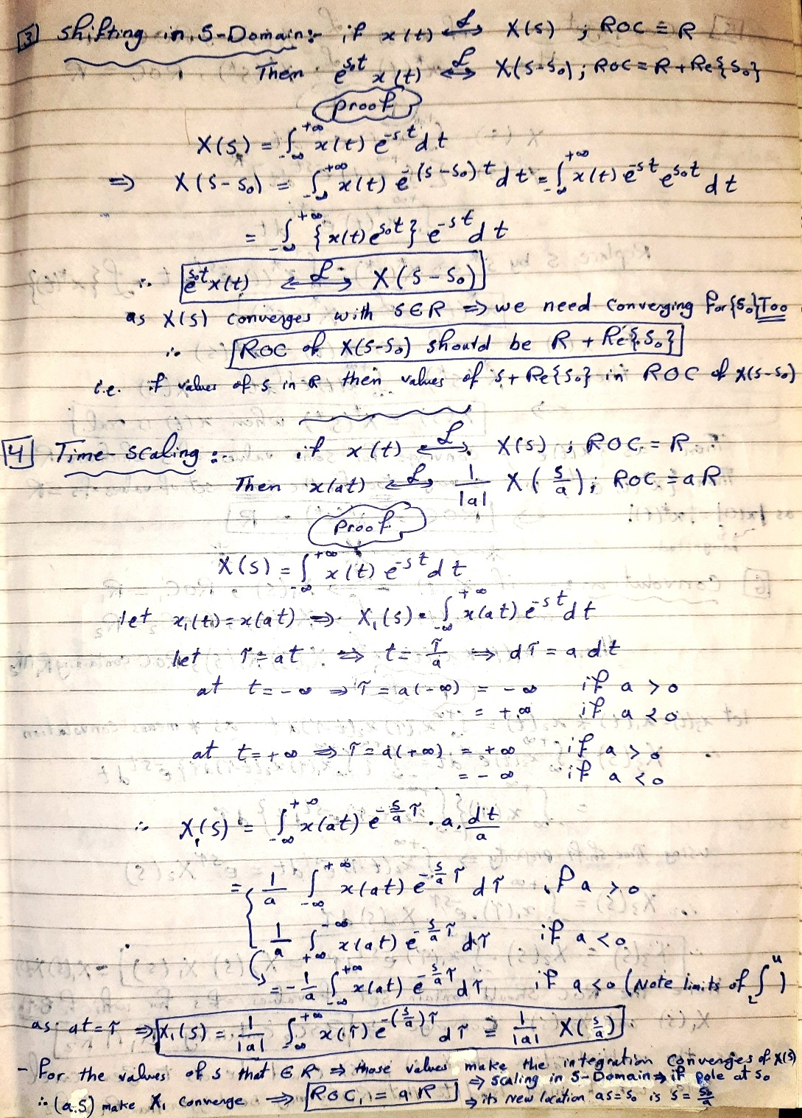
Laplace Transform Properties.

Slide 26
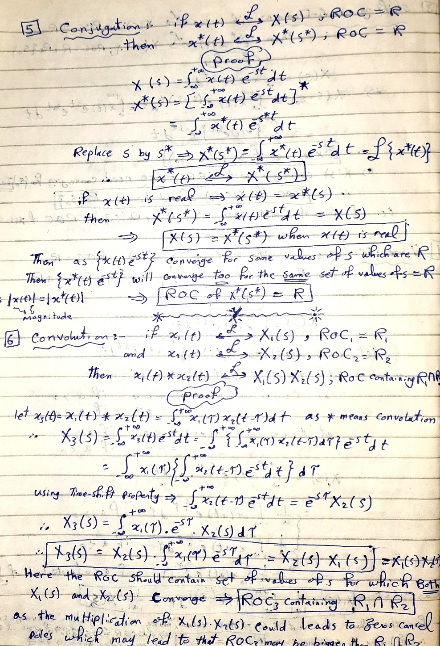
Laplace Transform Properties.

Slide 27
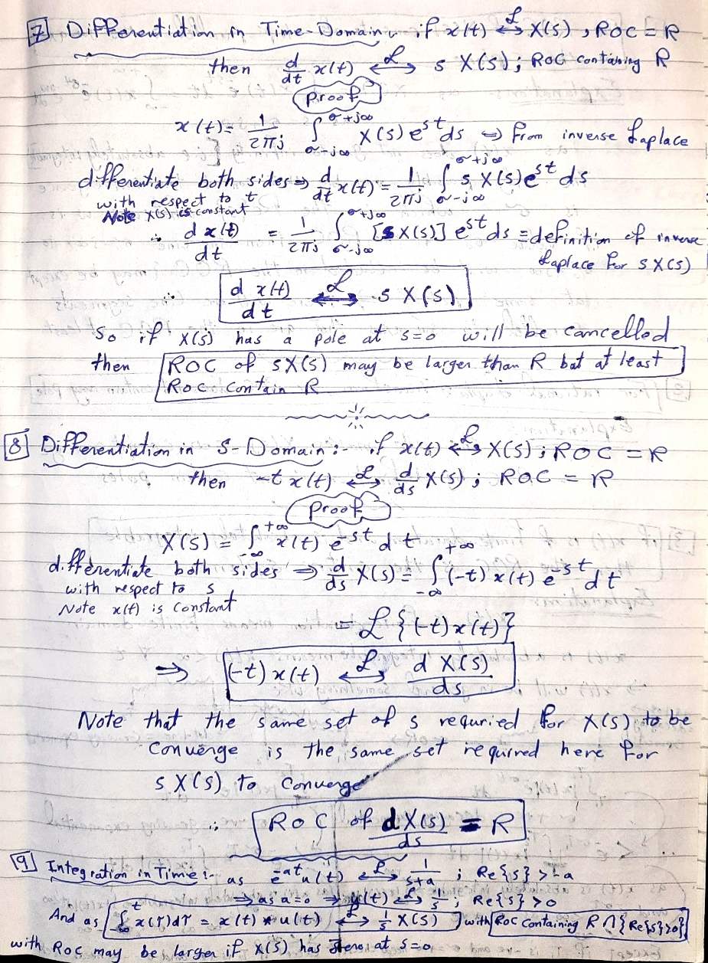
Laplace Transform Properties.

Slide 28
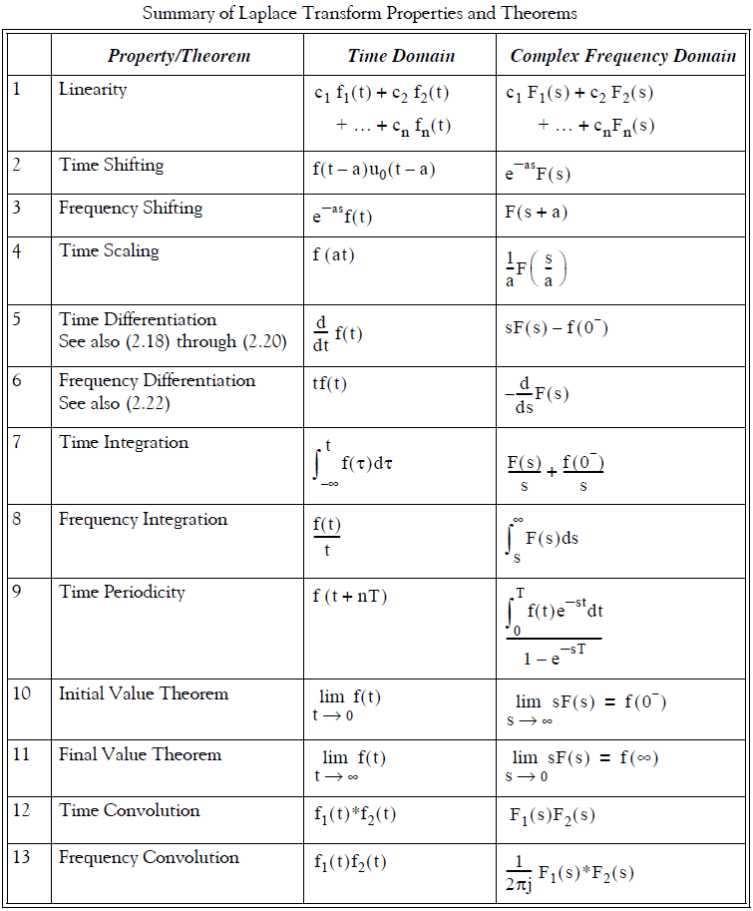
Laplace Transform Properties.

Slide 29
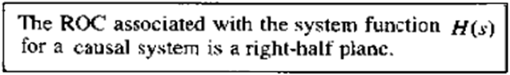
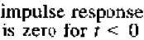
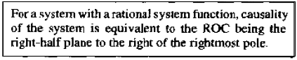
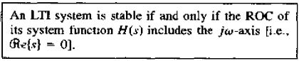
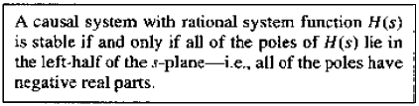
Laplace Transform Properties.
Causality:
for LTI Systems
Stability:
for LTI Systems

Slide 30
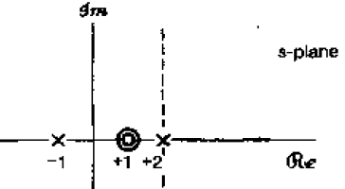
Laplace Transform Properties.
➔ If the degree of numerator is less than the degree of denominator
There will be zero(s) at infinity
EX:
If s = ∞ ➔ H(s)=0
➔ If the degree of numerator is greater than the degree of denominator
Then there will be pole at infinity
EX:
If s = ∞ ➔ H(s) = ∞
➔ If a root (either zero or pole) has an exponent then there is a number of zeros or number of poles equal to the exponent at the location of this root
EX:
has two zeros at s=1 and two poles at s=-1 and at s=-2

Slide 31
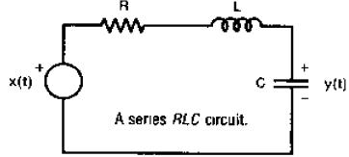
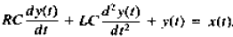
Example to show the benefits of Laplace Transform.
Consider the following circuit :
What is the system function of this system?
We have the input voltage across the voltage source and the output voltage across the capacitor. And we know that as ALL components are connected in series then:
The sum of individual voltages on each component = the voltage source
As we get the system equation, we can exploit the Laplace Transform and its properties to directly calculate the system function H(s):

